Slide 1
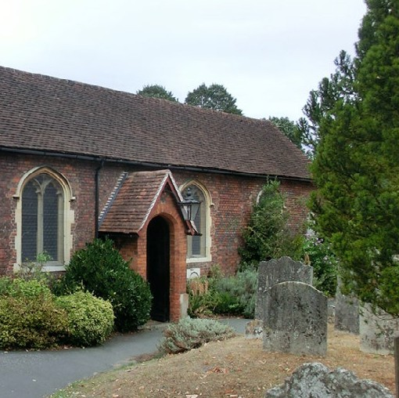
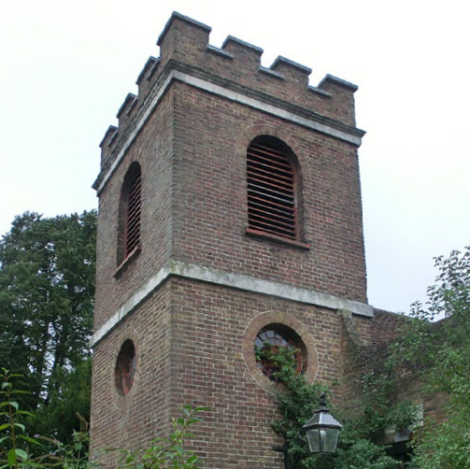
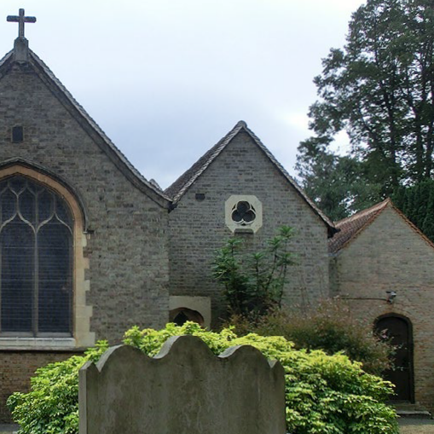
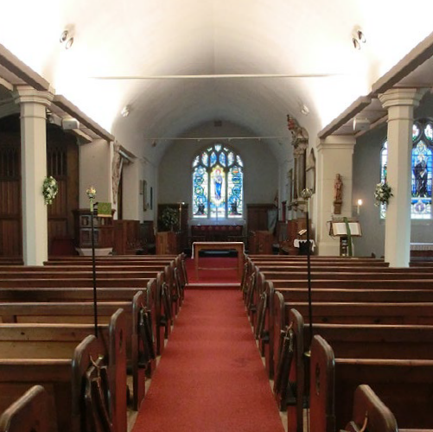
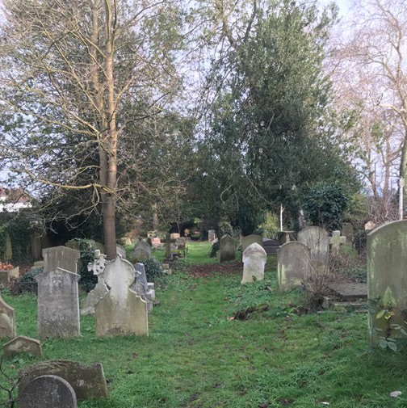
Building Anew
@ St Mary with St Alban
Open Day 12 May 2024

Slide 2
Building Anew Our Vision
We aspire to be
An open and welcoming church
Serving our local community
Fostering faith and friendship
Bringing people of all ages together
For the glory of God
/2

Slide 3
Building Anew Our church building
We worship in an historic parish church set within a beautiful churchyard
As custodians of this precious resource, it is our responsibility to ensure our church continues to flourish into the future, serving our community and providing for its spiritual needs
Our church is a wonderful place to connect with God but should also be a place to connect with each other and connect with our community
/3

Slide 4
Building Anew Meeting our challenge!
Our church, dating back to the 16th century, needs vital facilities to make it accessible, support our connections and extend our welcome to all
To achieve this, over the past 5 years we have…
started with fundamentals, first commissioning a Conservation Management Plan to assess the architectural and heritage significance of all aspects of the church and churchyard
formed a Project Team and Governance Group, under the guidance of the PCC
prepared a detailed Needs Assessment and Project Brief
appointed an architect and team of expert consultants (covering heritage, archaeology, ecology, accessibility, structural engineering, building services and costings)
examined a wide range of options to establish the best scheme
commissioned surveys and site investigations (addressing archaeology, ground conditions, trees, etc)
conducted extensive consultations with the congregation, local community, local groups, Diocese of London, Historic England, Georgian Society, Church Buildings Council and Richmond Council
/4

Slide 5
Building Anew Project timeline and status
September 2018: Conservation management plan commissioned
February 2019: Building Anew project launched and Governance Group formed
May 2019: Needs assessment completed and project brief prepared
September 2019: Architect ( ), engineers and other key consultants appointed
May 2020: Concept design completed
June 2020 onwards: Consultations with internal and external stakeholders
December 2022: Planning permission granted by Richmond Council
July 2023: Fundraising campaign launched
April 2024: Faculty granted by the Diocese of London
2025: Building work to start (subject to sufficient funds having been raised)
/5

Slide 6
Building Anew Fundraising campaign – plan
Total project cost estimate = £1.25 million (by Quantity Surveyor)
Fundraising appeal target = £1 million (launched in July 2023 by Archdeacon)
Source | Fundraising Plan
Church reserves (legacies, etc) allocated to the project | £250,000 | 20%
Congregation and local community (donations) | £525,000 | 42%
Trusts and foundations (grants) | £325,000 | 26%
Local businesses (donations and sponsorship) | £100,000 | 8%
Events and sponsored activities (donations and sponsorship) | £50,000 | 4%
Total | £1,250,000 | 100%
/6

Slide 7
Building Anew Fundraising campaign – progress (by early May 2024)
Source | Funds Raised | % of Target | Comments
Church reserves (legacies, etc) allocated to the project | £250,000 | 100%
Congregation and local community (donations) | £192,650 | 37%
Trusts and foundations (grants) | £1,750 | 1% | Applications underway
Local businesses (donations and sponsorship) | £2,000 | 2% | Commencing June 2024
Events and sponsored activities (donations and sponsorship) | £6,400* | 13%
Bank interest | £1,200 | -
Total | £454,000 | 36%
* Excludes proceeds from Local History Supper on 11 May 2024
Events to-date include:
2 music concerts, churchyard teas, children’s art workshops, Christmas stocking appeal, ‘Big Teddington Tea Party’ and a sponsored ultra-marathon
/7

Slide 8
Building Anew Fundraising campaign – future plans
Upcoming events:
‘Buy-a-Brick’ appeal (15 June onwards)
Local history supper #2 (22 June)
Foreign currency donation scheme (June-Sept)
Vinyl record auction (June – November)
Back-to-school party, for adults! (28 Sept)
Vicar’s sponsored parachute jump (TBC)
Quiz evening (5 October)
Thomas Traherne concert and talks (October)
Vicar’s sponsored ‘massathon’ (TBC)
Grant applications planned:
Benefact Trust
Joseph Rank Trust
Valencia Communities Fund
City Bridge Foundation
National Lottery Heritage Fund
National Churches Trust
Garfield Weston Foundation
Laing Family Trust
/8

Slide 9
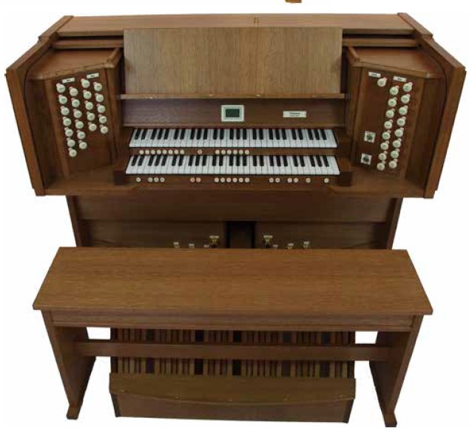
Building Anew Approved scheme: Internal re-ordering
First, we will make the very best use of our existing footprint
To achieve this we propose to:
Replace the pipe organ with a state-of-the-art digital organ with 20 drawstops, releasing the space in the organ chamber
Convert the current organ chamber into the new sacristy with a mezzanine floor above for storage
Convert the current sacristy into the new choir vestry
Makin Digital 2-Manual Drawstop Organ Console
This enables us to minimise the size of the extension needed
We will demolish the current choir vestry (assessed by experts to be a poor-quality building of little architectural significance) and build new facilities in an extension adjoining the north side of the church
/9

Slide 10
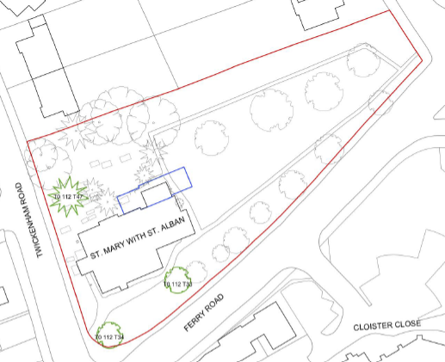
Building Anew Approved scheme: Extension
The proposed new extension adjoining the north wall of the church will offer:
Fully accessible toilet facilities with baby-changing
Kitchenette to serve drinks and simple refreshments
Flexible meeting space for church and local community activities – the ‘Garden Room’
Internal and external step-free access
Facilities often taken for granted, but which our church sorely lacks!
Location & footprint of proposed extension
/10

Slide 11
Building Anew Approved scheme: Extension
As well as offering practical solutions to our needs, the extension will include:
Glass-walled passageway with a gentle ramp providing step-free access from the north aisle to the toilets and Garden Room, opening up views to our glorious churchyard
Contemporary coloured-glass artwork installation in the east wall, echoing the existing stained-glass windows providing flow from new to old
Direct step-free access from the churchyard to the east
/11

Slide 12
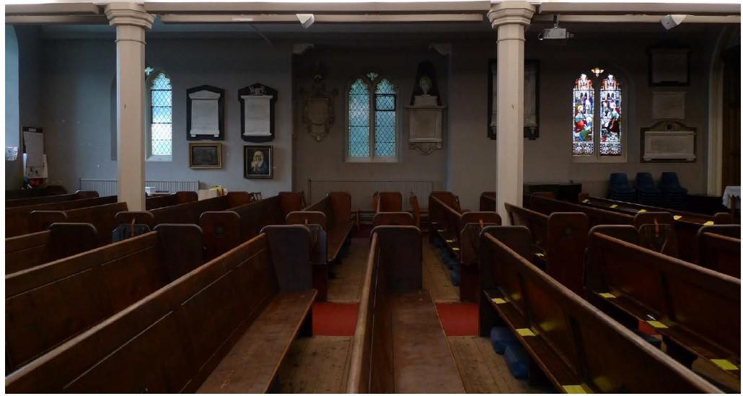
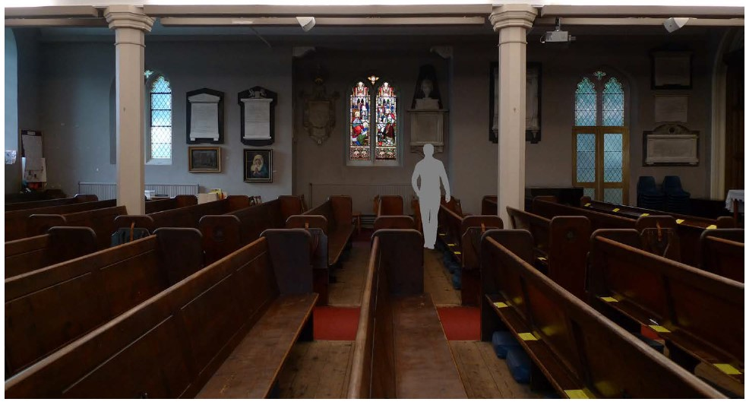
Building Anew Approved scheme: Extension
Access to the extension will be via a new glass doorway in the north aisle, expanding the opening where the current stained-glass window is located
The stained-glass window will be relocated to the central window opening in the north aisle
/12

Slide 13
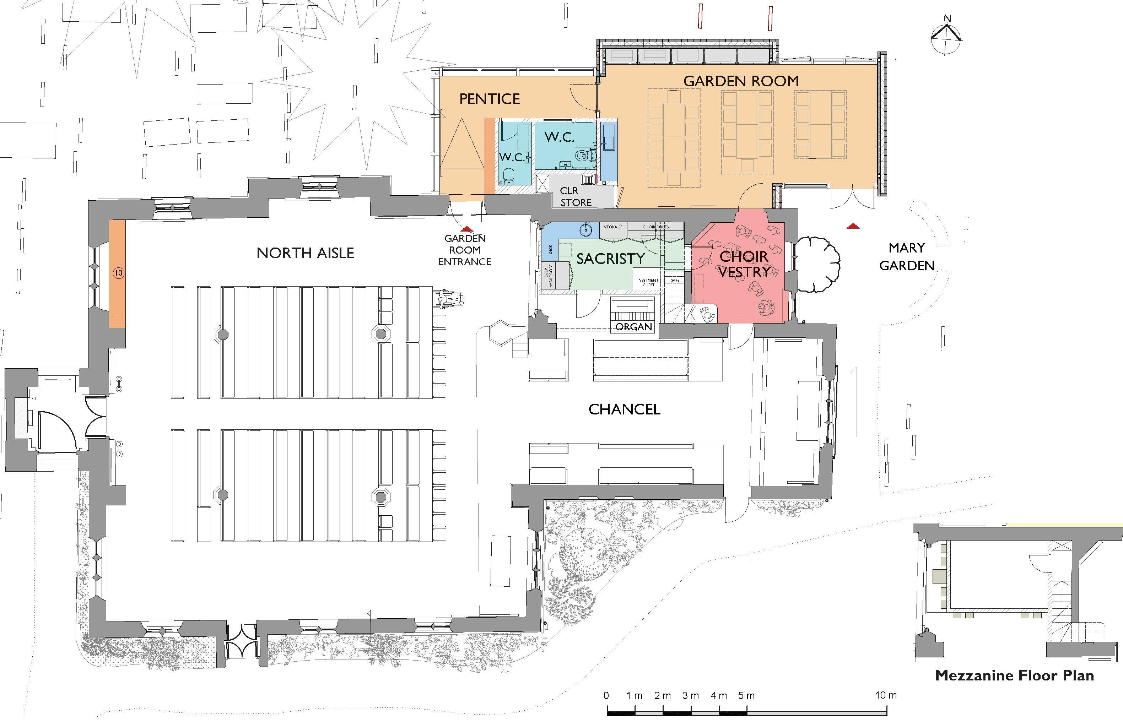
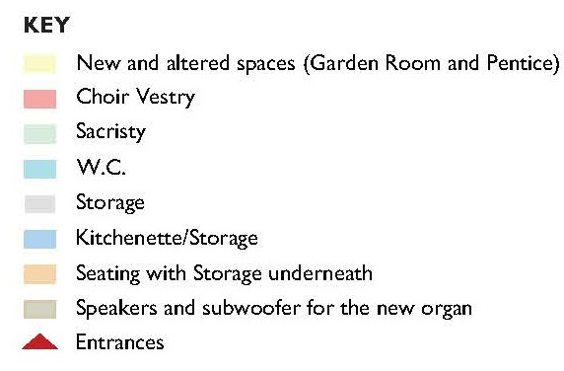
Building Anew Approved scheme: Floorplan
/13

Slide 14
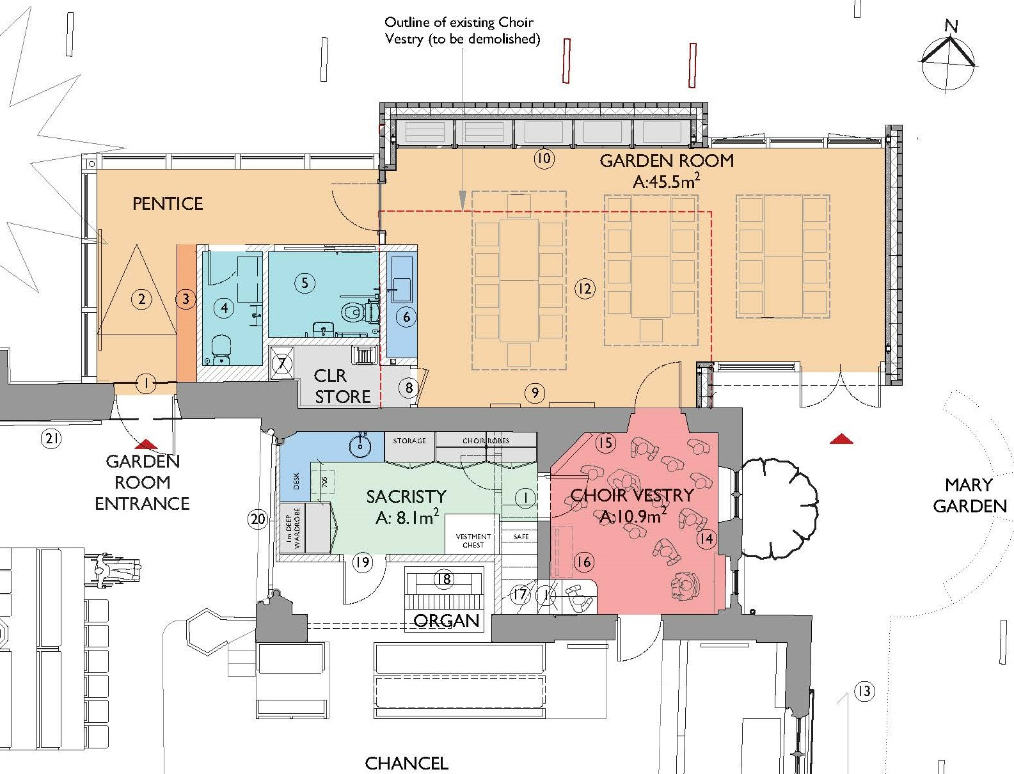
Building Anew Approved scheme: Floorplan (details)
/14

Slide 15
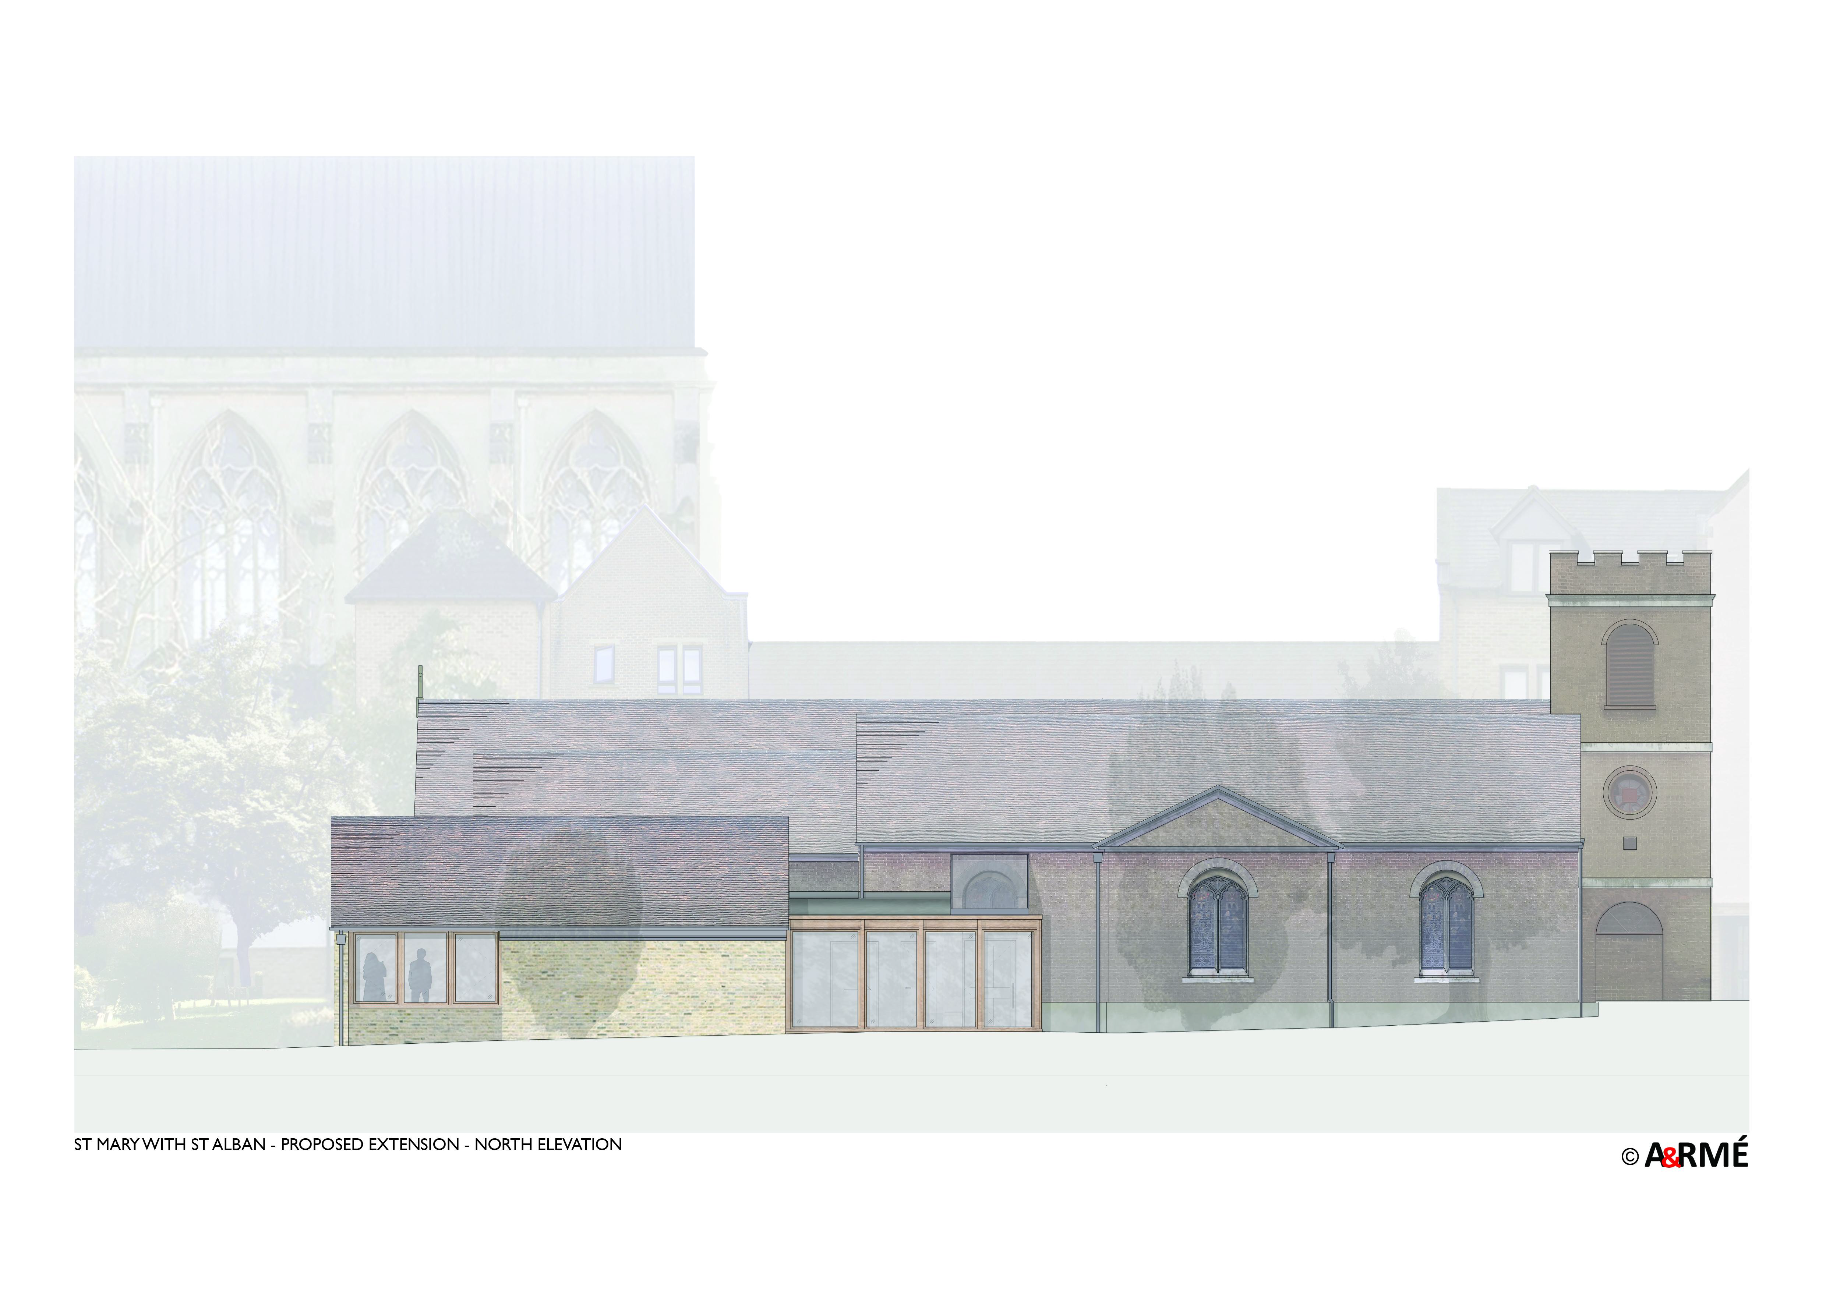
Building Anew Approved scheme: North elevation
/15

Slide 16
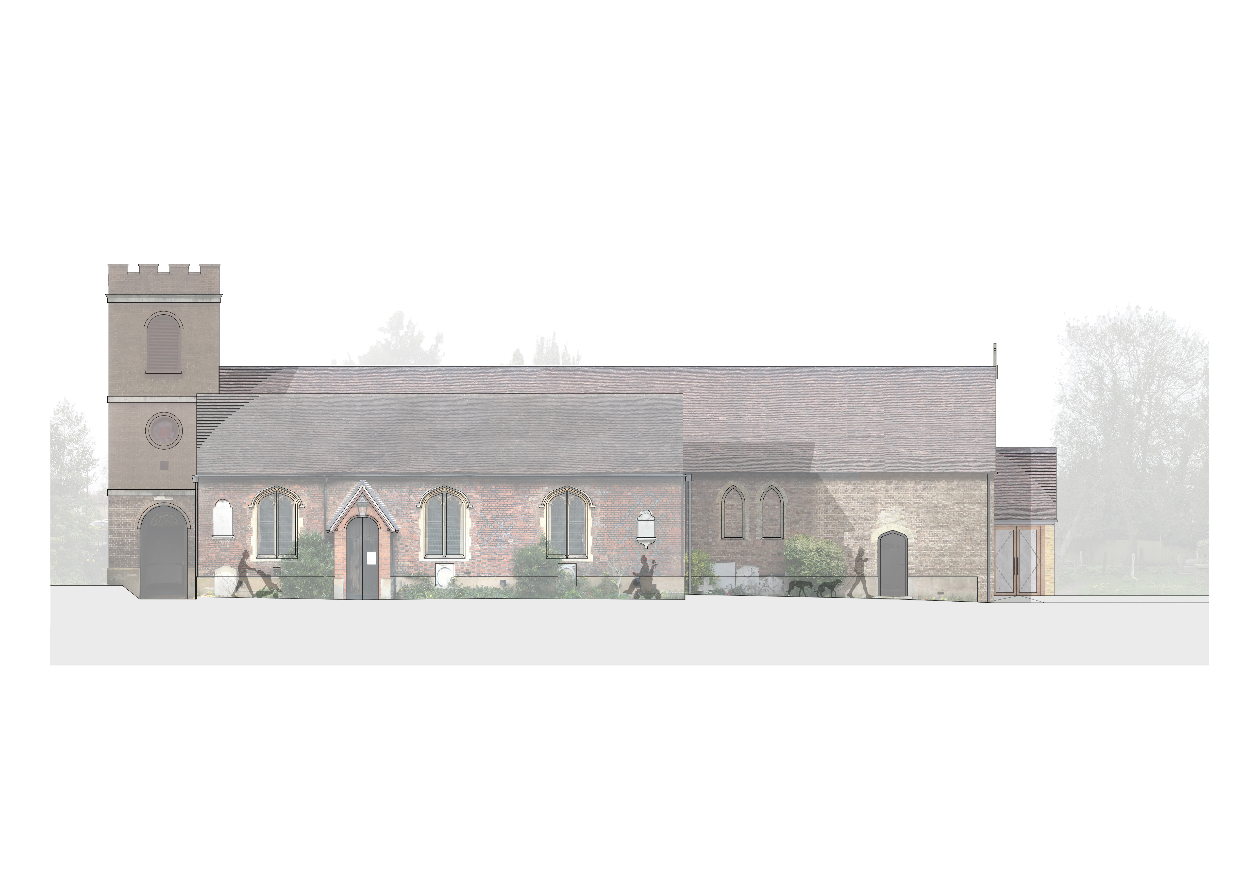
Building Anew Approved scheme: South elevation
/16

Slide 17
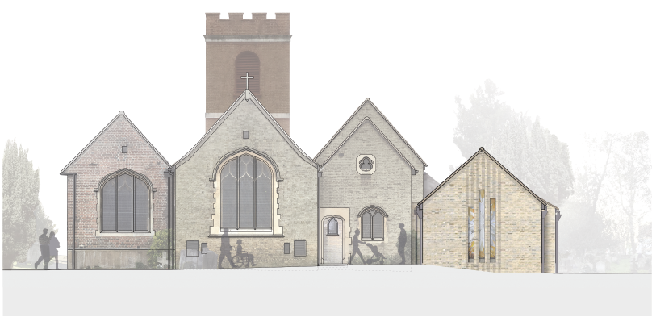
Building Anew Approved scheme: East elevation
Contemporary coloured-glass artwork
Cross-section from above of brickwork profile around artwork windows
/17

Slide 18
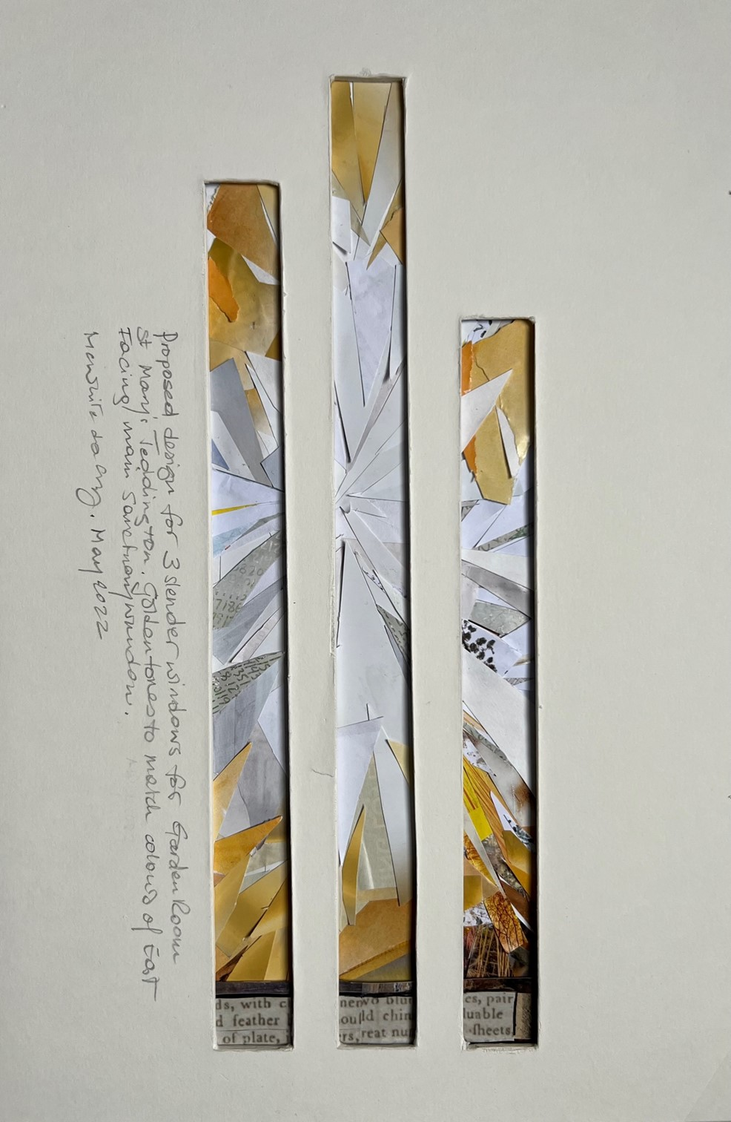
Building Anew Approved scheme: Integrated artwork in east wall of extension
Proposed design for 3 slender windows for Garden Room St Mary’s Teddington. Golden tones to match colours of East facing main sanctuary window
View from inside the Garden Room looking eastwards
/18

Slide 19
Building Anew Conclusion
“We do not ignore maturity. Maturity consists in not losing the past while fully living in the present with a prudent awareness of the possibilities of the future.”
― Thomas Traherne
/19

